Slide 1
E-Commerce Customer Segmentation &
Prediction

Slide 2

E-commerce Customer Segmentation and Prediction
“ In the e-commerce domain, this project uses machine learning to segment customers and predict churn through RFM analysis and clustering. By identifying key customer behaviors, it aims to enhance engagement, improve retention, and boost profitability, enabling data-driven strategies for sustained business growth. "
Presented By – Raghav P. Bhadada

Slide 3

Agenda
Introduction
Data Gathering and Reading
Data Preprocessing
Key Data Insights
Feature Engineering
RFM Analysis
Clustering Analysis
Churn Prediction
Deployment
Conclusion
Actionable Recommendations

Slide 4
Introduction
Key Questions:
Objective:
Segment customers based on behavior and predict churn to improve retention and profitability.
Tools Used:
Python,
Machine Learning,
RFM Analysis,
Clustering.
Q1. Who are the most valuable customers ?
Q2. Which customers are at risk of churn ?
Q3 . How can we improve customer engagement?

Slide 5


Churn Prediction
STEP
Predict which customers are likely to stop purchasing.
07
STEP
Clustering Analysis
06
Group customers with similar behavior using clustering techniques.
RFM Analysis
STEP
Segment customers based on RFM scores.
05
WORK FLOW
STEP
Feature Engineering
04
Create RFM metrics to quantify customer behavior.
Key Data Insights
STEP
03
Extract meaningful patterns and trends from the data.
STEP
Data Preprocessing
02
Analyzing and visualizing data patterns to clean and prepare data for analysis
Data Gathering & Reading
STEP
01
Describe data sources and fields.

Slide 6
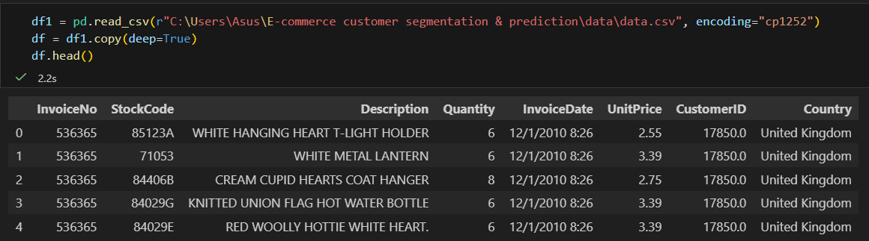
Data Fields:
01. Data Gathering and Reading
Tools for Loading Data:
Python (Pandas, NumPy)
Customer ID,
Invoice Number,
Stock Code
Invoice Date,
Product Description,
Quantity,
Unit Price,
Country.

Slide 7
02. Data Preprocessing
Outcome: Clean, structured data ready for analysis.
S3
Convert date fields to datetime format.
S4
Remove duplicate entries.
S1
Handle missing values and outliers.
S2
Standardize / normalize data.

Slide 8
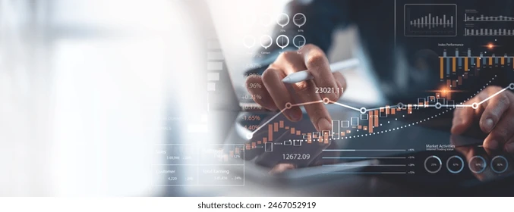
03. Key Data Insights
Most Active Countries (Bar Chart)
High-Priced Products (Table)
Top Revenue-Generating Products (Bar Chart)
Revenue Trends Over Time (Line Chart)
Monthly Revenue Distribution (Bar Chart)
Sales by Country (Map Visualization)

Slide 9
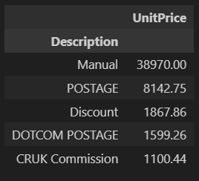
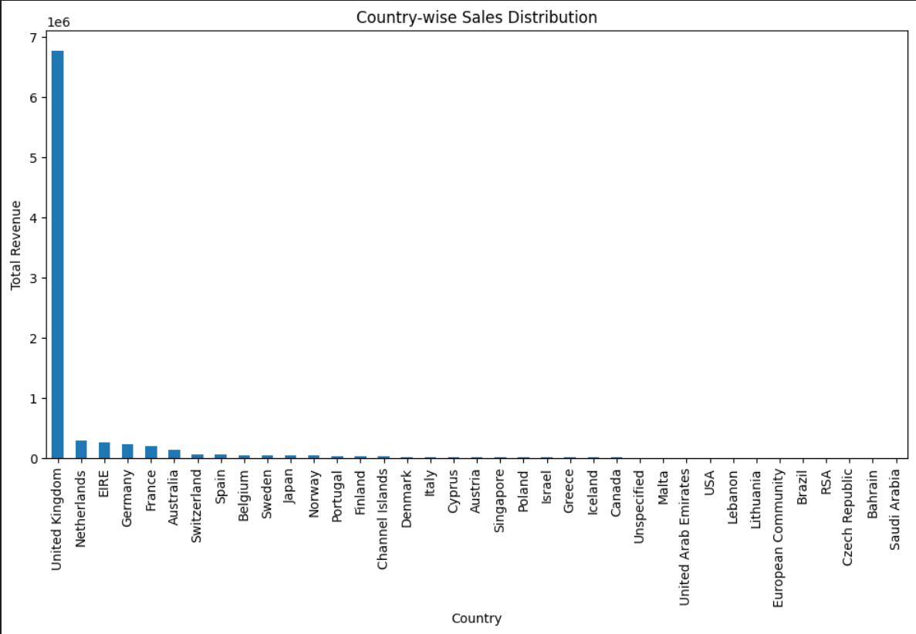
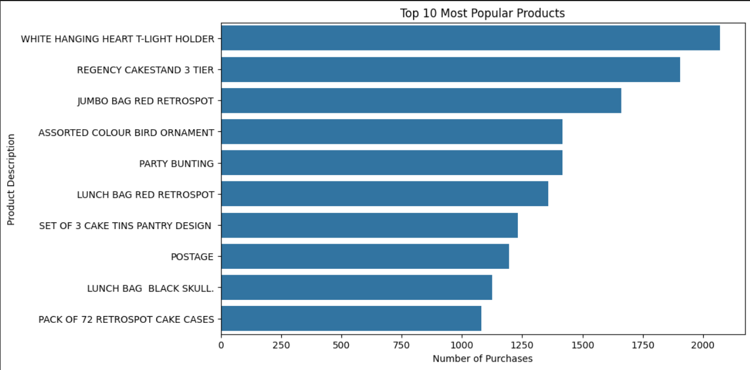
High-priced Products
(Table)
Most Active Countries (Bar Chart)
Top Revenue-Generating Products
(Bar Chart)

Slide 10
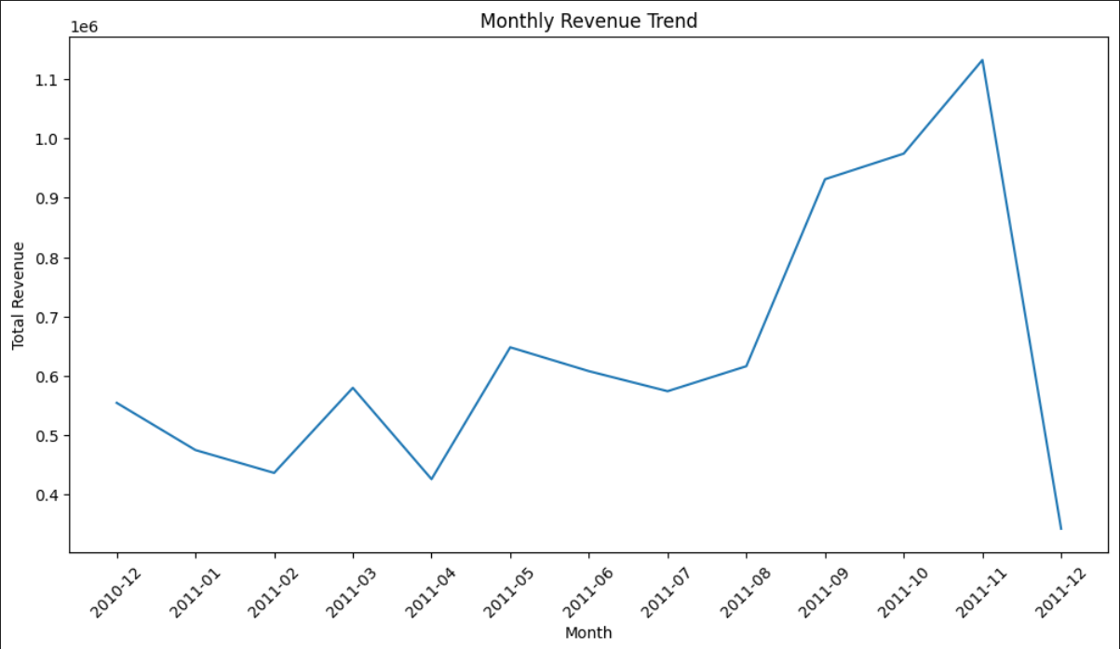
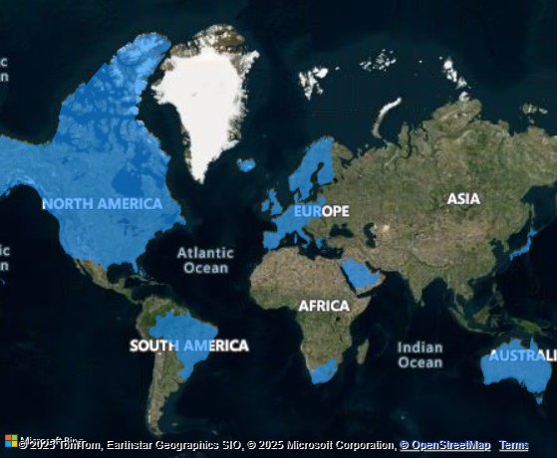
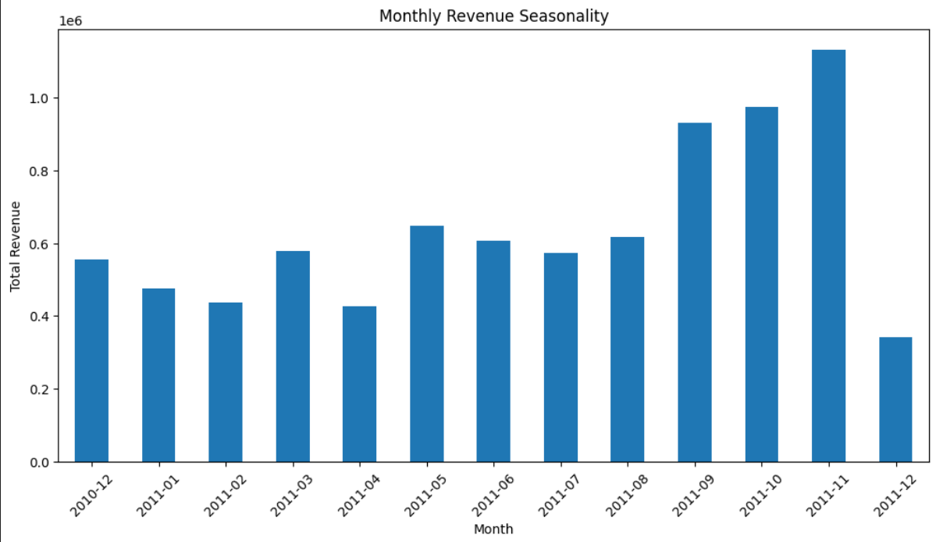
Revenue Trends Over
Time (Line Chart)
Sales by Country (Map Visualization)
Monthly Revenue Distribution
(Bar Chart)

Slide 11
04. Feature Engineering
Recency | Frequency | Monetary
How recently a customer made a purchase | How often they purchase | How much they spend
RFM Metrics
Purpose: Quantify customer behavior for segmentation.

Slide 12
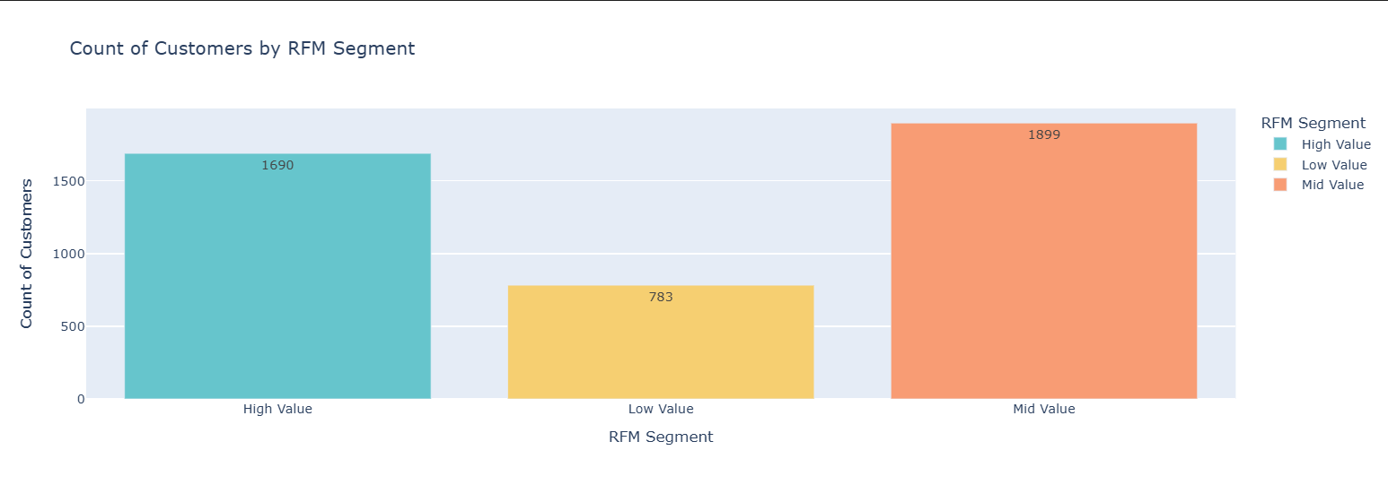

Slide 13
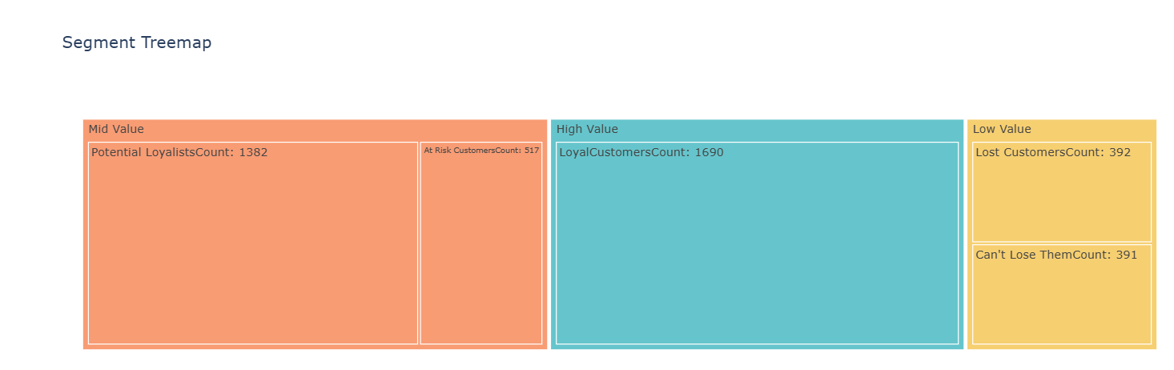
05. RFM Analysis
Actionable Insights:
Customer Segments:
Loyal Customers (444): High engagement and spending.
Potentially Loyal Customers: Moderate RFM scores.
At-Risk Customers: Likely to churn.
Can’t Lose Customers: Low RFM scores, high risk of churn.
Retain high-value customers.
Re-engage at-risk customers.

Slide 14
Clusters Identified:
06. Clustering Analysis
Cluster 1: High-value loyal customers and at-risk high spenders.
Cluster 2: Moderate to high spenders with recent inactivity.
Cluster 3: Core high-value, deeply loyal customers.
Cluster 4: High-frequency customers with declining engagement.
Techniques Used:
K-means,
DBSCAN,
Hierarchical Clustering.
Recommendations:
Loyalty programs for high-value clusters.
Reactivation campaigns for at-risk clusters.

Slide 15




Clustering Analysis
High-Frequency
4
High-frequency customers with declining engagement.
Core High-Value
3
Deeply loyal customers.
Moderate to High
2
Moderate to high spenders with recent inactivity.
High-Value Loyal
Loyal customers and at-risk high spenders.
1

Slide 16
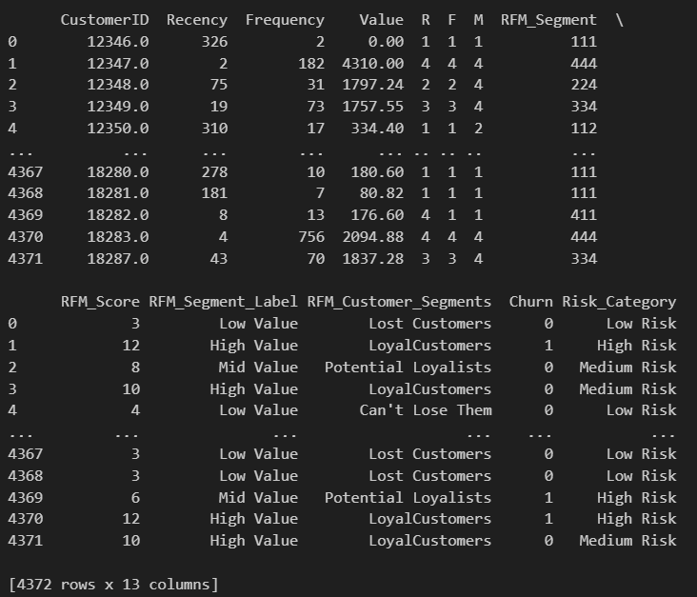

07. Churn Prediction
Actionable Insights:
Launch retention campaigns.
Provide personalized offers.
Model Used:
Logistic Regression, Random Forest.
Features:
RFM scores, purchase patterns.
Outcome:
Identify customers likely to churn.

Slide 17
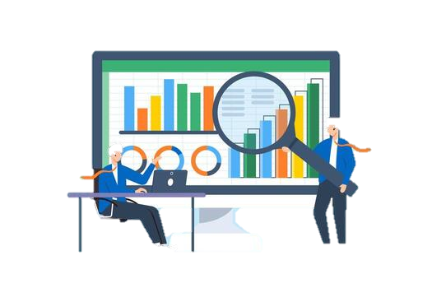
Deployment
Deploy Model
Create Dashboards
In a production environment.
For real-time monitoring.
Tools Used
Python (Gradio) for deployment, Tableau / Power BI for dashboards.

Slide 18
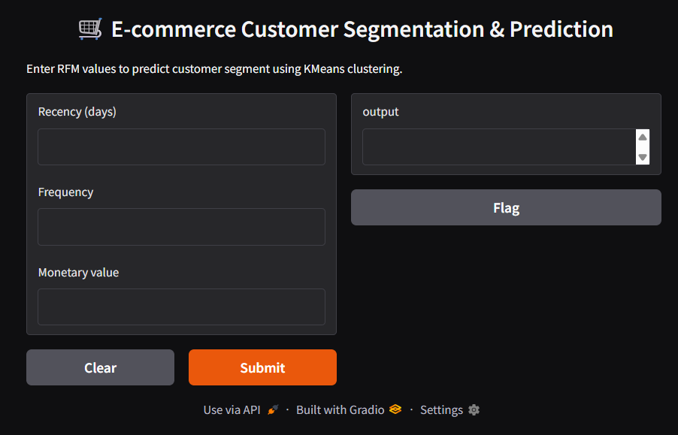

Slide 19



Conclusion
Key Takeaways:
RFM and clustering provided actionable customer insights.
Churn prediction helps in proactive retention strategies.
Business Impact:
Increased Revenue Through Targeted Marketing
Reduced Marketing Costs & Improved Customer Retention

Slide 20



Actionable Recommendations:
From RFM Analysis:
RFM focuses on Recency (R), Frequency (F), and Monetary value (M) — each gives direct business levers.
Retain loyal customers with VIP programs and Re-engage at-risk customers with targeted campaigns.
From Clustering:
Clustering groups customers with similar overall behavior, enabling segment-level strategies.
Focus on high-value clusters with exclusive offers and Reactivate declining clusters with personalized incentives.
From Churn Prediction:
Churn prediction enables proactive intervention instead of reactive analysis.

Slide 21
Questions ?

Slide 22
Thank You!

